Slide 1

Capstone Project-4
Book Recommender System Individual Janhavi Shembade

Slide 2

Contents:-
1.Business Context/Understanding
2.Objective
3.Data Summary
4.Data Preprocessing
5.EDA
6.Recommendation System
7.Popularity Based Recommender System
8.Collaborative Filtering Recommender System
9.Conclusion

Slide 3
Business Problems Understanding:-
During the last few decades, with the rise of Youtube, Amazon, Netflix, and many other such web services, recommender systems have taken more and more place in our lives.
From e-commerce (suggest to buyers articles that could interest them) to online advertisement (suggest to users the right contents, matching their preferences), recommender systems are today unavoidable in our daily online journeys.
In a very general way, recommender systems are algorithms aimed at suggesting relevant items to users (items being movies to watch, text to read, products to buy, or anything else depending on industries).
Recommender systems are really critical in some industries as they can generate a huge amount of income when they are efficient or also be a way to stand out significantly from competitors.
The main objective is to create a book recommendation system for users.

Slide 4
Objective:-
To show them personalized advertising or recommendations on specific news or products.
To Stimulate demand and actively engage users.
To recommend the most relevant items to a particular user or customer.
To provide recommendations based recorded information on the users' preferences

Slide 5
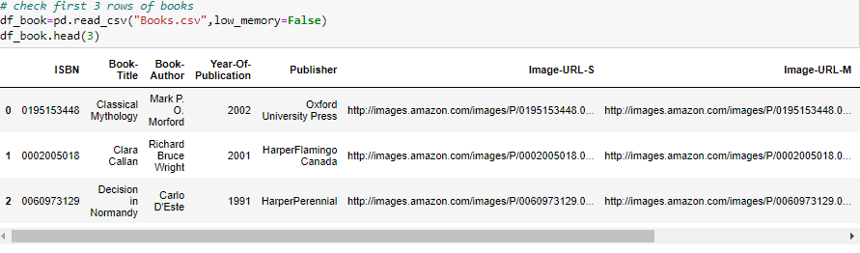
Data Summary:-
BOOK DATA:-
There are 8 columns and 271360

Slide 6
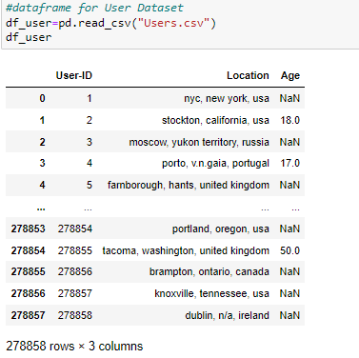
Contd..
USER DATASET
There are 3 columns and 278858 rows.

Slide 7
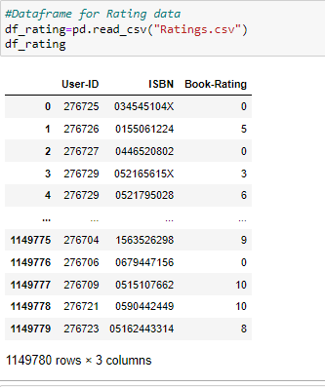
Contd..
Ratings Dataset:-
There are 1031136 3 columns

Slide 8
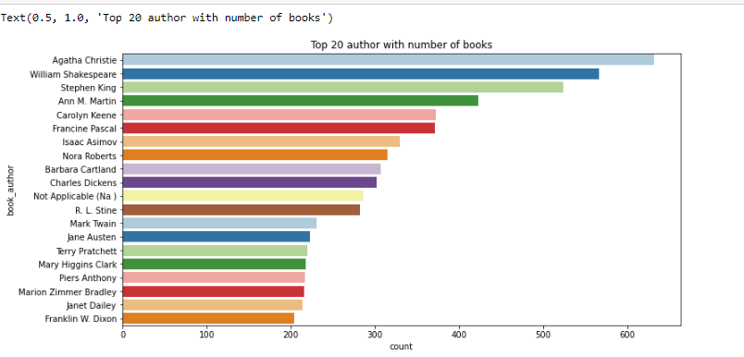
Data Visualization
Below graph shows the Top 20 Authors with number of books
Among top 20 Authors the highest number of books has been hold by Agatha Christie. Agatha Christie is leading at top with more than 600 counts, followed by William Shakespeare

Slide 9
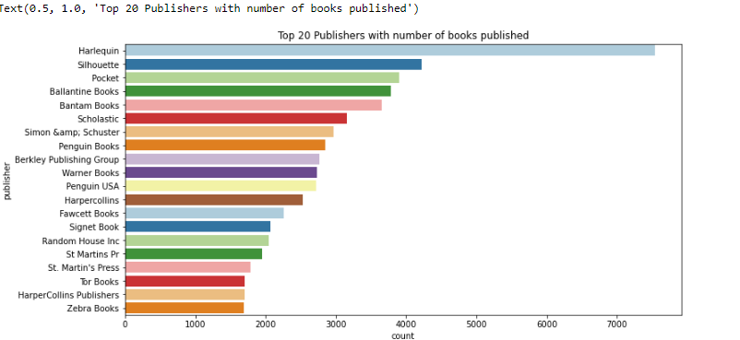
Cont..
Top 20 Publishers with number of books published
Among top 20 Books Publishers the top 20 number of book publisher is Harlequin

Slide 10
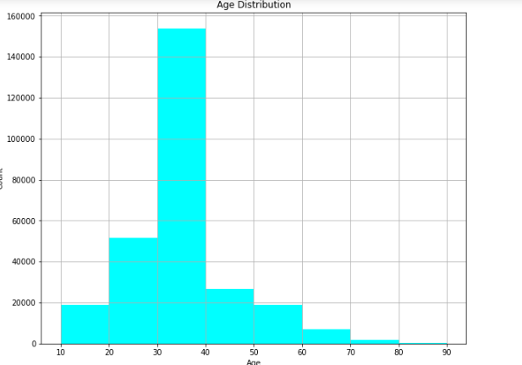
cont..
Age Distribution
Most User are from the age of 10 to 70 years of age and max users age is in 30 to 40

Slide 11
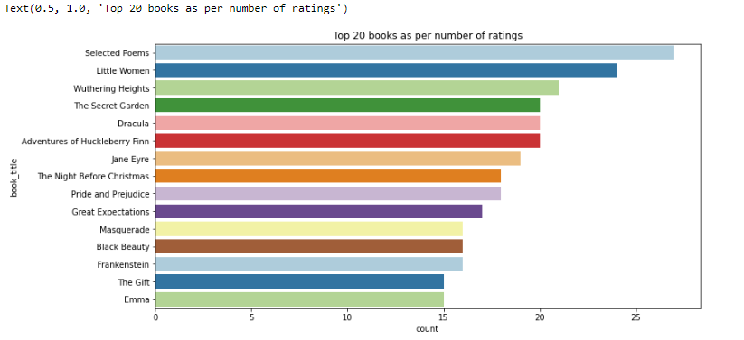
Ratings
Top 20 books as per number of ratings
0
Top 20 book which having highest number of ratings are given to Selected poems followed by Little women

Slide 12
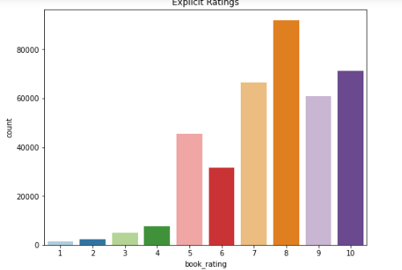
Book Rating
Out of 10 Almost all users give rating above 5 and max rating is given by 8

Slide 13
Popular Based Filtering
As the name suggests Popularity based recommendation system works with the trend. It basically uses the items which are in trend right now.
This is particularly useful when you don't have past data as a reference to recommend product to the user.
It is not tailor fit for any particular group of audience or movie.

Slide 14
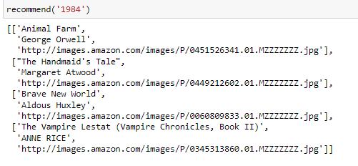
Collaborative Filtering Based Recommender System
Collaborative Filtering is the most famous application suggestion engine and is based on calculated guesses; the people who liked the product will enjoy the same product in the future.
Collaborative Filtering (CF) is the most popular and widely used approach for Recommender System.
which tries to analyze the user's interest over the target item on the basis of views expressed by other like-minded users.

Slide 15
conclusion
Agatha Christie has 600 number of book which is top one author who have large number of book.rather than william shakespeare is great author but it followed by agatha.
Harlequin has most number of books published, followed by Silhouette.
Number of Books published in yearly are between 1950 - 2005.
Most of the users are in 20-30 and are 30-40 prefer more books.
As per ratings "Selected Poems" has been rated most followed by "Little Women". The countplot shows users have rated 0 the most, which means they haven't rated books at all.
The top 10 books recommendation as per ratings with top "The lovely Bones: A novel" with 707 book ratings. But this are not based on some recommendation system. They are top 10 books as per ratings.
Harlequin has most number of books published, followed by Silhouette.
Number of Books published in yearly are between 1950 - 2005.
Most of the users are in 20-30 and are 30-40 prefer more books.
As per ratings "Selected Poems" has been rated most followed by "Little Women". The countplot shows users have rated 0 the most, which means they haven't rated books at all.
The top 10 books recommendation as per ratings with top "The lovely Bones: A novel" with 707 book ratings. But this are not based on some recommendation system. They are top 10 books as per ratings.
Harlequin has most number of books published, followed by Silhouette.
Number of Books published in yearly are between 1950 - 2005.
Most of the users are in 20-30 and are 30-40 prefer more books.
As per ratings "Selected Poems" has been rated most followed by "Little Women". The countplot shows users have rated 0 the most, which means they haven't rated books at all.
The top 10 books recommendation as per ratings with top "The lovely Bones: A novel" with 707 book ratings. But this are not based on some recommendation system. They are top 10 books as per ratings.
Agatha Christie has 600 number of book which is top one author who have large number of book.rather than william shakespre is great author but it followed by agatha
Harlequin has most number of books published, followed by Silhouette.
Number of Books published in yearly are between 1950 - 2005.
Most of the users are in 20-30 and are 30-40 prefer more books.
As per ratings "Selected Poems" has been rated most followed by "Little Women". The countplot shows users have rated 0 the most, which means they haven't rated books at all.
The top 10 books recommendation as per ratings with top "The lovely Bones: A novel" with 707 book ratings. But this are not based on some recommendation system. They are top 10 books as per ratings.

